Slide 1
Fundamentals of Digital Entrepreneurship

Slide 2
Objectives and goals
At the end of this module you will be able to:
Understand the essentials of Digital Entrepreneurship
Acquire the basics of Digital Business knowledge
Recognize new IT solutions for Business Management
Find out more about a digital Start-Up

Slide 3
Didactic Unit 1.1 What is Digital Entrepreneurship

Slide 4
1.1 What is Digital Entrepreneurship
Definition of EU Commission:
“Digital entrepreneurship embraces all new ventures and the transformation of existing businesses through novel digital technologies.
[Digital enterprises] are characterised by a high intensity of utilisation of novel digital technologies (particularly social, big data, mobile and cloud solutions) to improve business operations, invent new business models and engage with customers and stakeholders”.
Source: https://publications.jrc.ec.europa.eu/repository/bitstream/JRC112439/jrc112439_eides_report.pdf

Slide 5
1.1 What is Digital Entrepreneurship
Definition of OECD:
“[…] the creation of digital businesses and the adoption of digital technologies by existing entrepreneurs. Under-represented population groups in entrepreneurship could be more likely to benefit from certain features of digital technologies for business creation and growth, including the lower start-up costs required for many digital businesses and the wider access to external markets offered by the internet”.
Source:
https://www.oecd-ilibrary.org/docserver/28e047ba-en.pdf?expires=1593152542&id=id&accname=guest&checksum=9127A1DB691D56E497C1B8FB901BA783

Slide 6
1.1 What is Digital Entrepreneurship
Definition of Digital Entrepreneurship – the Academic perspective:
“Digital entrepreneurship can be defined as entrepreneurial opportunities being created and pursued through the use of technological platforms and other information communicating equipment. Therefore, digital entrepreneurship may fall within many categories of business. As technology advances and cultivates, so too will these categories (e.g. marketing, sales, products, distribution, stakeholder management, operations) and new categories can potentially be fashioned”.
Source:
https://www.ncbi.nlm.nih.gov/pmc/articles/PMC7134220/

Slide 7
1.1 What is Digital Entrepreneurship
Understanding Digital Transformation
“Digital transformation refers to the economic and societal effects of digitalisation (i.e. the conversion of analogue data and process into machine-readable format) and digitalisation
(i.e. the use of digital technologies and data, as well as interconnections that result in new
or modified activities)”.
Source:
https://www.oecd-ilibrary.org/science-and-technology/going-digital-shaping-policies-improving-lives_9789264312012-en

Slide 8
1.1 What is Digital Entrepreneurship
Core drivers of digital transformation as identified by OECD*:
Internet of Things (IoT)
“An extension on internet connectivity into devices and objects, allowing them to be remotely monitored and controlled. This enables new business models, applications and services based on data collected from devices and objects”.
*Sources:
https://www.oecd-ilibrary.org/science-and-technology/going-digital-shaping-policies-improving-lives_9789264312012-en
https://www.oecd-ilibrary.org/science-and-technology/artificial-intelligence-in-society_eedfee77-en
https://www.oecd-ilibrary.org/science-and-technology/cloud-computing-the-concept-impacts-and-the-role-of-government-policy_5jxzf4lcc7f5-en

Slide 9
1.1 What is Digital Entrepreneurship
Core drivers of digital transformation as identified by OECD*:
Next-generation wireless networks (5G and beyond)
“Improvements in wireless networks include higher speeds (i.e. 200 times faster than 4G) and networks that better support diverse applications through the virtualisation of the physical layers.
This will improve connectivity between devices and objects, and is critical for applications such as self-driving vehicles”.
Big data analytics
“Data that is characterised by high volume, velocity and variety, often sourced from IoT. Big data can be used to develop new products and services, processes, organisational methods and markets, and enables data-driven innovation”.

Slide 10
1.1 What is Digital Entrepreneurship
Core drivers of digital transformation as identified by OECD*:
Artificial Intelligence (AI)
“The ability of machines and systems to acquire and apply knowledge, including performing a variety of cognitive tasks such as sensing, processing language, pattern recognition, learning, and making decisions and predictions.
AI is already part of daily life (e.g. recommendations from streaming entertainment services) and will increasingly drive new kinds of software and autonomous robots (i.e. they can make and execute a decisions without human input)”.

Slide 11
1.1 What is Digital Entrepreneurship
Core drivers of digital transformation as identified by OECD*:
Blockchain
“A ledger or spreadsheet that is maintained and stored across a network of computers.
The network regularity updates the database in all locations so that all copies are always identical. Should someone try to change information stored in the block, the “chain” is broken and all nodes in the network would be aware of it. Applications of blockchain technology includes smart contracts, cryptocurrencies and supply chain management”.

Slide 12
1.1 What is Digital Entrepreneurship
Digital Entrepreneurship: seeking a broader definition
Digital Entrepreneurship is not only blockchain, Artificial Intelligence, and other highly complex ICT applications, but also mere entrepreneurship in digital environment.
Digital Entrepreneurship embraces all new ventures and the transformation of existing businesses through the exploitation and valorisation of digital technologies…

Slide 13
1.1 What is Digital Entrepreneurship
Just an example:
Listed among the “Success Stories” showcased by the EIT Digital website (European Institute of Innovation and Technologies), Plugify is an online platform that provides to amateur musicians, DJs and Bands a free digital space where to promote their arts.
Promoters, Pubs and Clubs’ owners can then access the platform and book the artist/musician of their preference via the platform itself.
Basically, Plugify operates as an online agency: for its revenues streams it relies on a small fee charged from each single booking intermediated by the platform

Slide 14
Didactic Unit 1.2 Digital Business Environment

Slide 15
1.2 Digital Business Environment
Problem Solving for Digital Ecosystems
Digital-friendly aspiring entrepreneurs are asked to fully embrace an enlarged portfolio of skills and competences.
These empowering tools rely for the most on “intangible” intellectual resources mastered through training and experience, such as:
– Creativity & Critical Thinking
– Active Listening and Dependability
– Relational Decision Making
– Benchmarking
– Stress-Test Management
– Data Literacy

Slide 16
1.2 Digital Business Environment
1. Creativity & Critical Thinking
Digital-oriented entrepreneurship embraces common challenges with out-of-ordinary approaches that are nurtured through intense lateral thinking sessions.
The emergence of such a risk-taking mindset allows firms to navigate in uncertain contexts with awareness and great responsibility for both business profitability and the people that are impacted by it.

Slide 17
1.2 Digital Business Environment
2. Active Listening and Dependability
The practice of active listening allows firms and executives to intercept and decode the “signals” coming from markets, customers and competitors and that impact future strategies and action plans.
The dependability of these data is essential in order to assure great reliability upon each Decision Making assumption.
People in charge of Planning tasks must consider: Who is the source of these information? Where does it came from? Has it already been confirmed or dismissed?

Slide 18
1.2 Digital Business Environment
3. Relational Decision Making
Wise digital entrepreneurs are well aware that, despite their experience, they might still miss / forget / ignore a “piece of the puzzle”.
Problem solving in the digital era requires the contribution and the engagement of multiple organisational actors, each of which is provider of a unique point of view on the context.
Not surprisingly, problem solving and decision making appear as two processes highly collaborative-oriented.

Slide 19
1.2 Digital Business Environment
4. Benchmarking
One of the easiest and most intuitive way to solve a challenging problem is by observing and replicating what others have done in similar scenarios.
Benchmarking is a traditional tool of Marketing Studies still highly exploited by practitioners and experts.
Those in charge of such analysis need to assess with great precision how the reference scenario is effectively relevant to the current one; a precondition from which strongly depends the ultimate impacts and benefits of the analysis itself.

Slide 20
1.2 Digital Business Environment
5. Stress-Test Management
Several technologies allow for the simulation of plausible future scenarios.
The availability of such information assures 3 strategic advantages:
The concrete opportunity to have a look on near futures so to implement from today highly consistent decisions
The assessment of all current strategies and objectives in relation to future competitive scenarios
The evaluation of how far the firm is able to withstand external disruptions that might potentially emerge in the near future

Slide 21
1.2 Digital Business Environment
6. Information and Data Literacy
Information and Data Literacy is related to the capability to analyse, elaborate and critically decode digital data.
Being “digitally illiterate” does not necessarily implies technical computer science knowledge – it is also related to the ability to discern the information coming from the digital environment while evaluating its reliability.

Slide 22
1.2 Digital Business Environment
ORM – Online Reputation Management
Online Reputation Management (ORM) concerns the monitoring, evaluation and empowerment of the firms’ public perception at the eyes of customers, competitors, investors/shareholders and general public.
Numerous studies have shown that firm’s public image in the online domain represents one of the most important strategic assets for a business.

Slide 23
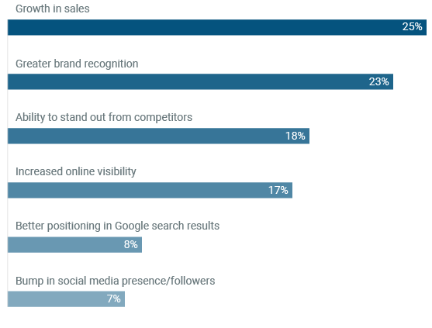
1.2 Digital Business Environment
Achievement business experience because of ORM
Source: The Importance of Online Reputation Management for Businesses, Clutch (2018)
https://clutch.co/pr-firms/resources/importance-online-reputation-management-businesses

Slide 24
1.2 Digital Business Environment
Online Reputation is a complex phenomenon.
The core elements of ORM revolve around three essential pillars of Business Ethics and Corporate Social Responsibility:
Fairness
Transparency
Trustworthiness

Slide 25
1.2 Digital Business Environment
Fairness
In business and management, Fairness refers to the ability of executives and decision makers to set goals, priorities and actions plans without the risk to arm anything and anyone (i.e. the natural environment, the civil society, the employees, etc.).
In other words, being “fair” means being respectful of others’ diversities and interests.

Slide 26
1.2 Digital Business Environment
Transparency
Transparent organisations disclose with clarity all publicly relevant information about how they implement their production, where the resources come from and how they are processed.
An honest communication about performance indexes contributes to strengthen the organisation’s public image and reputation.

Slide 27
1.2 Digital Business Environment
Trustworthiness
Customers will not turn to the offer of a company that does not arouse their trust.
Aside sales and market share, Trustworthiness represents one of the most relevant priorities of a firm.
Being perceived as trustworthy translates in a very effective mean to sustain the retain process of new customers and nurture the relationship with the loyal ones.

Slide 28
1.2 Digital Business Environment
How to be ORM-oriented?
Online Reputation represents a core function in Business Management, so much that in the last few years it opened the opportunities for a brand-new market.
With the help of specific diagnostic tools that keep track of a firm’s OR performance, experts and private firms provide to the market their skills, competences and consultancy services on ORM.

Slide 29
1.2 Digital Business Environment
These tracking tools are designed to record in real time the reputation performance of a firm.
Some of these tools are highly specialised on restricted digital contents with strong impact potentials on firm’s profitability
(i.e. tweets, TripAdvisor's reviews, etc.).
For a more comprehensive list of:
ORM specialist around the globe;
https://themanifest.com/online-reputation-management/agencies
ORM tools;
https://www.searchenginejournal.com/best-online-reputation-monitoring-tools/250769/#close

Slide 30
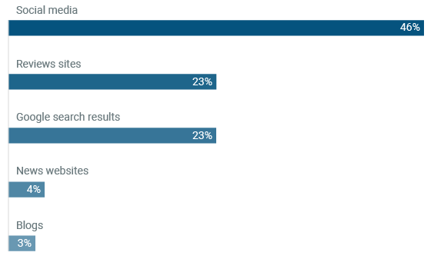
1.2 Digital Business Environment
Top Five platforms for monitoring Brand Reputation
Source: The Importance of Online Reputation Management for Businesses, Clutch (2018)
https://clutch.co/pr-firms/resources/importance-online-reputation-management-businesses

Slide 31
1.2 Digital Business Environment
Most importantly, ORM-oriented businesses are those who culturally embraced the strategic relevance of ORM and Public Image Perception.
Entrepreneurs and organisations should commit to ORM through the exploitation of a new competitive paradigm that leverages simply on what people says and how they recognise the value proposed by the firm.

Slide 32
1.2 Digital Business Environment
How to be ORM-aware?
Pay great attention to the surrounding environment
Respect other’s point of views even when they conflict with your beliefs
Acknowledge your mistake and be open to constructive criticism
Do not let your pride turn into arrogance – be respectful and honest
Rather than on results, focus on the outcomes of your actions

Slide 33
Didactic Unit 1.3 Novel Tech opportunities for Businesses

Slide 34
1.3 Novel Tech opportunities for Businesses
1. Cloud Computing
Cloud Computing solutions allow you to exploit very important hardware and software resources from remote.
These services are provided by specialised companies that – depending on their offer – might allocate or manage the resources on behalf of the client.

Slide 35
1.3 Novel Tech opportunities for Businesses
Cloud Computing Taxonomy
On the basis of how resources are designed, allocated and distributed | On the basis of the actual provided service
Private Cloud. The client benefits from a customised service specifically engineered for its needs by an external provider. | IaaS – Infrastructures as a Service. Also known as “pay-per-use”, the IaaS model allows the use of an Infrastructure (i.e. virtual storage space) in exchange of a fee.
Public Cloud. The most common form of Cloud. The service belongs to the provider that – in exchange of a monthly/yearly fee – guarantees its use and availability to external parties. | PaaS – Platform as a Service. Highly common among those who need a “test-ground” to validate the development of their own software/application.
Hybrid Cloud. A modular combination of the two previous forms. | SaaS – Software as a Service. A turnkey delivery of the software itself from the developer to the customer.

Slide 36
1.3 Novel Tech opportunities for Businesses
2. Data Analytics
A formal definition of Data Analytics describes it as a way to decode digital data highlighting highly meaningful information so to establish “predictive knowledge models” rather than descriptive ones.
In Business Management, Data Analytics is an essential strategic tool at the disposal of executives and directors.

Slide 37
1.3 Novel Tech opportunities for Businesses
From another perspective, Data Analytics stands as a testimony of an “an opportunity driven mindset”.
As such, all that it is required to embrace a Data Analytics framework is a balanced mixture of creative and calculating thinking.
Data Analytic is a field that gives great contributions to 2 business functions that commonly deal with large numbers and lots of information coming from the external environment:
Finance
Marketing

Slide 38
1.3 Novel Tech opportunities for Businesses
Exploiting Data Analytics in Business Settings:
Customer Experience and Brand Loyalty
Firms exploit big dataset that are gathered from Sales departments to: analyse the customers demand, intercept new trends and purchasing preferences, orientate the development of new products, boost technological innovation and design consistent communication strategies.
In other words, Data Analytics supports firms and executives to shape a profile snapshot of the modern customer base.

Slide 39
1.3 Novel Tech opportunities for Businesses
2. Advertising
From a broader perspective, Data Analytics helps organisations to understand the purchasing behaviour of customers (both potential and loyal) so to better canalise the communication and advertising efforts.
The ultimate objective is to match the right product to the right client while taking into great consideration her/his favourite purchase channel.

Slide 40
1.3 Novel Tech opportunities for Businesses
3. Risk Management
In this field, Data Analytics is mostly exploited to orientate investment decisions and to quantify some statistical models that cluster investment opportunities on the basis of the associated risks.
Banks and financial intermediates make use of these tools on a daily basis as highly effective risk-mitigation means.

Slide 41
1.3 Novel Tech opportunities for Businesses
4. Value Chain Management
The Value Chain transcription in a digital language allows for greater and more sophisticated analyses of the existing relations between one function and another.
These networks of knowledge flowing among different task-teams contribute to the emergence of an organisational collective awareness and empowers the perception that each staff has upon roles and responsibilities of the others.

Slide 42
Didactic Unit 1.4 The Inception of an Internet Start-up

Slide 43
1.4 The Inception of an Internet Start-up
Turning your idea into a profitable business
At inception, every firm emerged from a single idea that, once turned in motion, translated into a sustainable enterprise.
Business Ideas come from the recognition of the opportunity to meet a marked need that is currently satisfied only partially (or not at all).
Everyday reality provides great inspirations for potential Business Idea: the difficult part comes when trying to identify the ones that are viable entrepreneurially.

Slide 44
1.4 The Inception of an Internet Start-up
The development of a Business Idea can be reconducted to two phases:
1. The Structuring
In other words, it means giving order to thoughts; highlighting which elements are particularly significant and deserve greater focus from a conceptual perspective.
2. The Development
Once the theoretical pillars are settled, aspiring entrepreneurs move to consider the operational dimension taking note of what might be reconducted to an enabling factor of the rising firm.

Slide 45
1.4 The Inception of an Internet Start-up
The Structuring
It implies an in-depth analysis of:
Addressed needs and Demand side
Existing competitors (saturation degree of the market)
Customers’ profile
Value and Supply Chain structure
Market maturity and further margins of exploitation
External stakeholders with high impact and influence
Potential support networks
Business model

Slide 46
1.4 The Inception of an Internet Start-up
The Development
High priority is given to:
Potential source of capitals
- Business and Financial Planning
Distribution and supply channels
4 Ps Strategy
- Product (or Service) – design and testing
- Place
- Promotion
- Placement
Value Proposition and Projected Revenue Streams

Slide 47
1.4 The Inception of an Internet Start-up
Business Planning
The Business Plan (BP) is the formal document that provides a structured snapshot of the business. The content of a BP is normally articulated in few specific sections covering all main business dimensions:
Brief presentation of the business idea, the entrepreneurs and its core staff
Brief presentation of the product/service
Marketing Analysis (which market segment we are going to occupy)
Long-term development perspective
Environmental impact
Finance and expected profitability

Slide 48
1.4 The Inception of an Internet Start-up
Financial Planning
Finance disclosure is so important that it requires a separate document on its own, the Financial Plan (FP).
The FP concerns a synthetic but very comprehensive evaluation of the financial and economic capacity of a firm.
A robust FP refers to three documents representing also the three primary financial statements:
Balance Sheet – Assets vs Liabilities
Income Statement – Revenues vs Expenses
Cash Flow Statement – Incoming vs Outgoing cash

Slide 49
1.4 The Inception of an Internet Start-up
Stakeholders Engagement strategies
Before taking any concrete action, aspiring entrepreneurs should ask themselves:
Who are the most strategic stakeholders for my business?
What might be their interest and how do I meet their expectations?
What kind of impact can my business have on them? Is it direct or indirect?
Do they have a testimonial? Is there someone who stands for their interests?
How can I trigger their feedbacks?
What are the indirect benefits from their involvement?
How do I nurture their interest and what can I do to keep it alive?
Is there a right time to engage them?

Slide 50
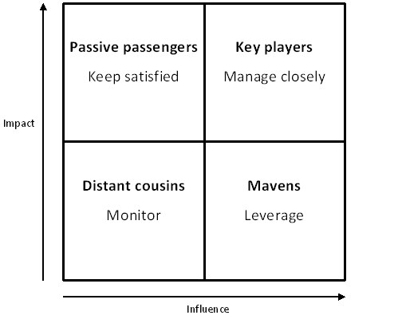
1.4 The Inception of an Internet Start-up
Stakeholders Engagement Matrix
On the basis of their impact and influence, Stakeholders are distributed in a very efficient matrix that summarize for each one of them their potential meaningfulness from a strategic perspective.
Source:
https://www.targetinternet.com/stakeholder-management-for-digital-marketers/

Slide 51
1.4 The Inception of an Internet Start-up
High Impact / Low Influence: Passive Passengers
Those who do not participate in ordinary business administration and do not take an active part in its strategies but still highly impacted by the on-going activities of the organisation; such as: communities, banks, local Policy Makers, shareholders, etc.
High Impact / High Influence: Key Players
Those who are highly resonant for a firm’s profitability and competitiveness; such as: buyers and suppliers, clients, competitors, research centres, etc.

Slide 52
1.4 The Inception of an Internet Start-up
Low Impact / Low Influence: Distant Cousins
The cluster with the lowest priority – they might represent a target as long as the firm is concerns to foster an “openness” agenda but they do not stand a strategic priority anyway (i.e. Primary and Secondary Schools)
Low Impact / High Influence: Mavens
Mavens represents a very interesting category to deal with: you cannot have as much impact on them as they have on you. Trade associations, opinion groups and labour unions are all highly influential within the organisations and they should be engaged as significant social partners

Slide 53
1.4 The Inception of an Internet Start-up
Networking and Funding Opportunities
From the beginning of the last decade, Start-up realities became a worldwide booming phenomenon.
Unlike “traditional” forms of enterprises, because of their high risk coefficient (lack of financial, cash-flow and credit history) it is very rare for a Start-up to access credit through the traditional credit line (i.e. the banking systems).

Slide 54
1.4 The Inception of an Internet Start-up
Start-up: What relations between finance and its lifecycles?
Start-up financing relies on dedicated socio-economic actors:
Super angels
Angels
Venture capitalists.
On the basis of the amount of resources they are able to guarantee, each one of the considered category intervene in a specific Start-up’s lifecycle.

Slide 55
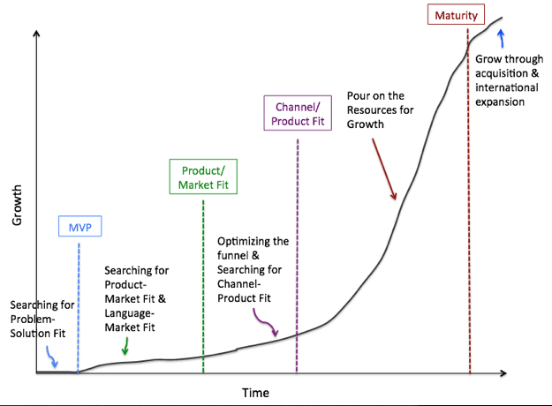
1.4 The Inception of an Internet Start-up
The 5 stages of a Start-Up are commonly recognised as:
Source: https://medium.com/tradecraft-traction/5-phases-of-the-startup-lifecycle-morgan-brown-on-what-it-takes-to-grow-a-startup

Slide 56
1.4 The Inception of an Internet Start-up
Solution Fit: Start-Up inception and business idea development
MVP (Minimum Viable Product): early design, development and testing phase of the product (service) + market segmentation and positioning strategy.
Market fit: first customer base and Demand responsiveness
Scale: exponential growth in brand awareness and market shares
Maturity: after five years from the foundation (marking the legal duration of a Start-up, the growth path can be pursued thanks two means only:
a) Acquisition, usually from big and established companies
b) Listing on stock exchange through an IPO (Initial Public Offering)

Slide 57
1.4 The Inception of an Internet Start-up
Solution fit | MVP | Market fit | Product fit | Scale | Maturity
Super Angels | Angels | Venture Capitalist
Represent the very first interlocutor of a Startupper: relatives, friends and any other person so close to the Startupper to give him/her enough money to sustain the genesis and first development of the business. | Angels are wealthy people looking for a profitable investment opportunity. Angels provide financial capitals in exchange for a direct percentage on profits / company shares. | Once Angels are on board, the Startupper has enough capital to start the actual business activity. From now on (flight momentum), Venture Capitalists are the one with the most consistent capital sums to the current Start-up financial needs.

Slide 58
1.4 The Inception of an Internet Start-up
Super Angels, Angels and Venture Capitalists:
Super Angels cannot be properly considered as investors: their contribution is not motivated by personal profit expectations but mainly by the genuine desire to see succeed their close ones.
VS
Solely motivated by profit logic, Business Angels and Venture Capitalists are both investors that expect a personal gain from the investment: their differentiation is motivated by the capital amount at their disposal (much higher for the second ones).

Slide 59
1.4 The Inception of an Internet Start-up
Elevator Pitch – Definition and Purpose
The first contact between an Investor and a Startupper starts from a very brief narrative of the business idea presented by the latter.
Such description is formally known as an “Elevator Pitch”: a catchy and intriguing presentation of the business idea aimed to conquer and enchant the interest of the investor.
Elevator Pitches are known for the characteristic of being extremely short and concise: the might last from a minimum of 30 sec. up to a maximum of 2 min.

Slide 60
1.4 The Inception of an Internet Start-up
The typical formula of an Elevator Pitch consists of:
A brief introduction of yourself
The unsatisfied need(s) underlying the business idea
Advantages and exploitable opportunities
Snapshot of the market status (is there any competitor already? What is our differentiation strategy? Etc.)
Current implementation stage and additional resources needed
Conclusions and formal financial requests
Because of the amount of information that one should be able to provide in such a short timespan, being able to develop an effective Elevator Pitch is generally considered as a very sophisticated competence on its own.

Slide 61
1.4 The Inception of an Internet Start-up
From there, if the investor(s) is (are) on board, the two parts start the negotiation of their agreement defining and finalising the conditions of the financing.
What generally happens is that the Angel or Venture Capitalist provides economic resources in exchange for shares on profits, partial ownership of a business unit (or more) and/or a mixture of both alternatives.

